Slide 1
IMDb Horror Scraper
Maria Brisolla, CMP-262

Slide 2
Introduction and Objective
This scraper sets out to scrape data from the Internet Movie Database (IMDb), with a particular focus on the horror genre.
The genre has had a massive resurgence over the last few years, and already has a few box office hits in the past 6 months alone. During times of intense societal movement, the horror genre often is filled with new entry upon new entry, often mirroring our own experiences in a cathartic sort of way.¹
The questions to be answered by the data are
Has the rating of horror movies gone up over the years?
Are movies in this genre getting longer?
Which subgenres are the most popular?
What are the highest rated horror films from 2020 to 2024?
This data can be used by potential future directors to provide guidance on what genres/subgenres they should focus in on more, as well as what is highly rated and why it is.
¹Dazed. “Why Is Horror so Popular Right Now?” Dazed, 28 Oct. 2024, www.dazeddigital.com/film-tv/article/64898/1/why-is-horror-so-popular-right-now-the-substance-genre.

Slide 3
Methodology
This scraper uses a combination of OMDb (Open Movie Database) and TMDb (The Movie Database) APIs to pull certain information from IMDb. OMDb’s API pulls for movie titles, while TMDb searches by genre, year, rating, and ID. It then prints this information onto a CSV file.
For subsequent questions, Seaborn math plots were utilized to truly visualize the answers.
The first one sorts all films by ratings that are greater than or equal to 7.0
The second one sorts all films by runtime that is greater than or equal to 100 minutes (~1 hr 40)
And finally, the last one accounts for what are the most popular subgenres within horror.
Some other tools used
Python ‘time’ function
Pandas
CSV files
Requests
TQDM (progress meter for runtime)
Seaborn math plots
Jupyter Notebook

Slide 4
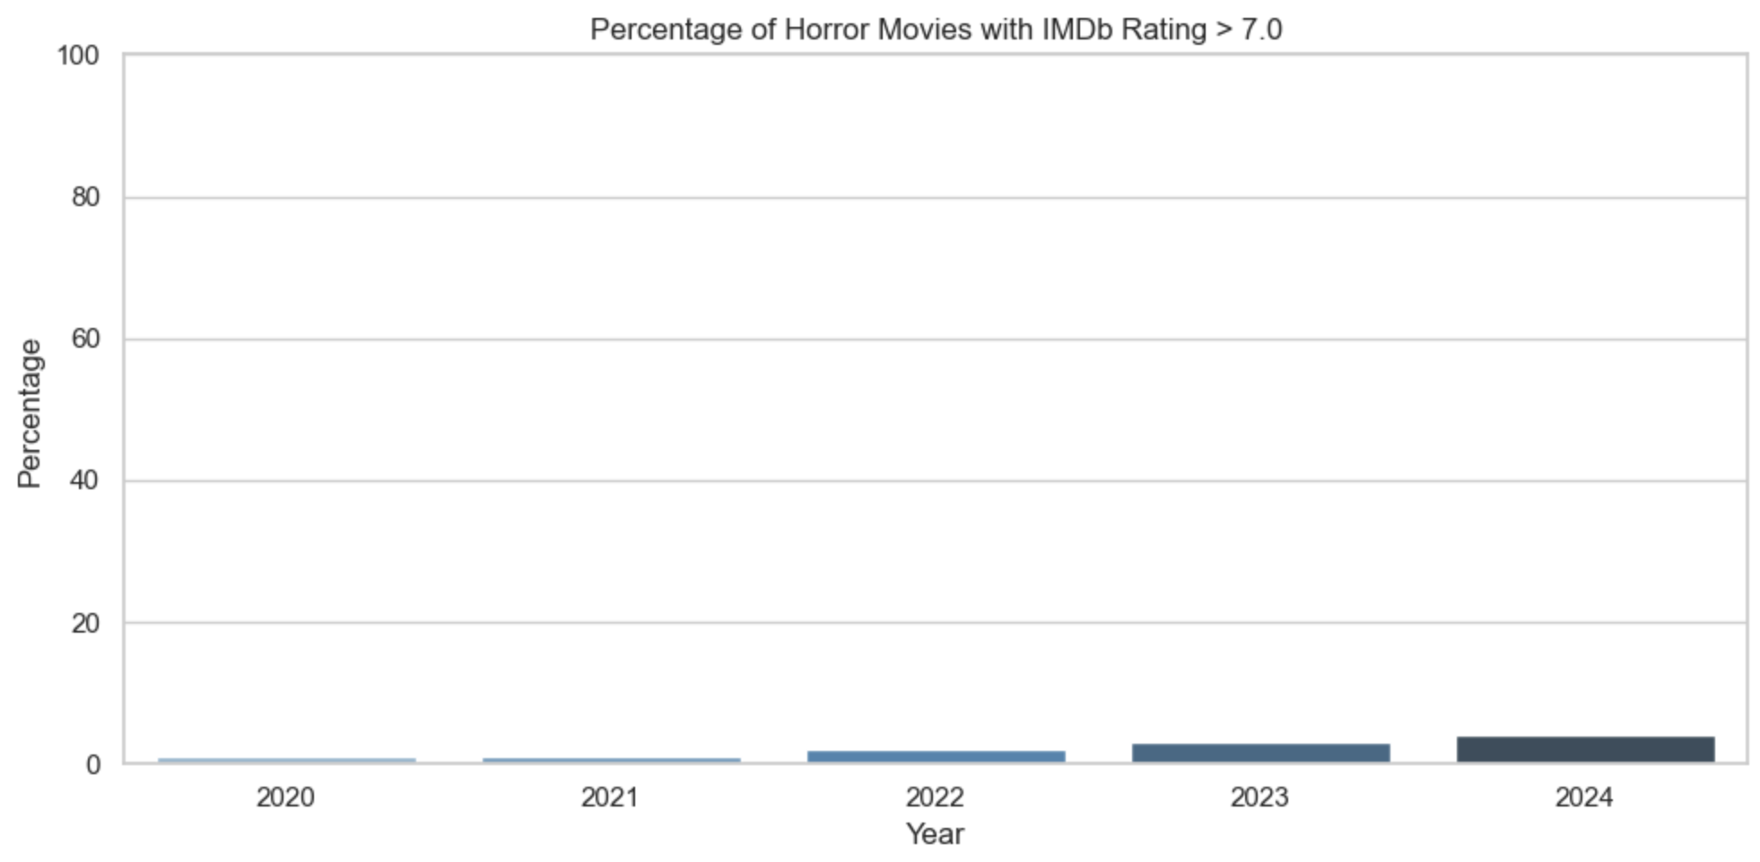
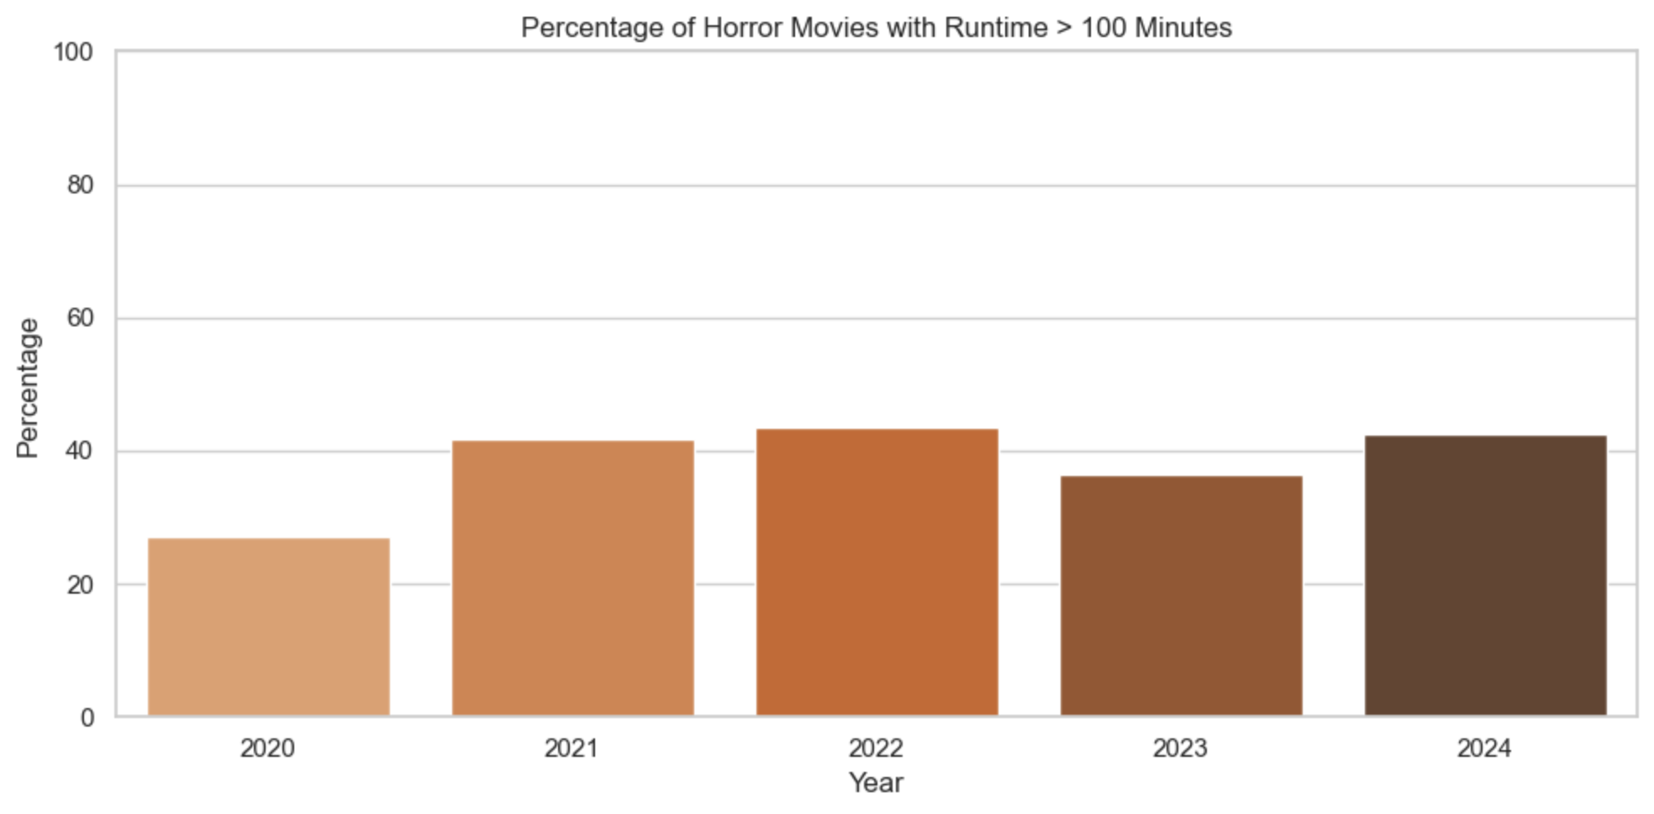
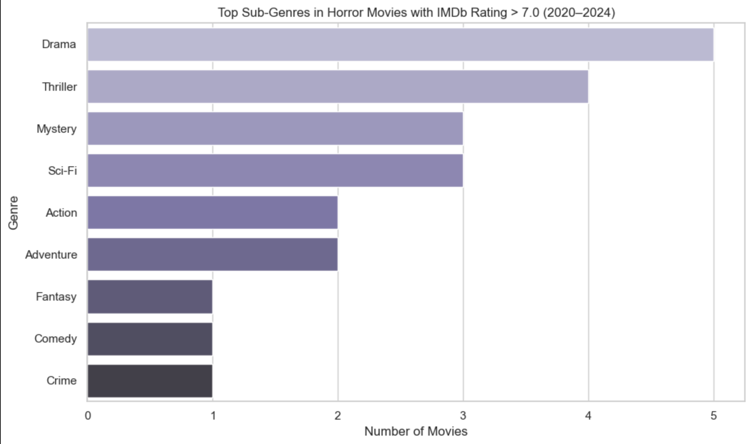
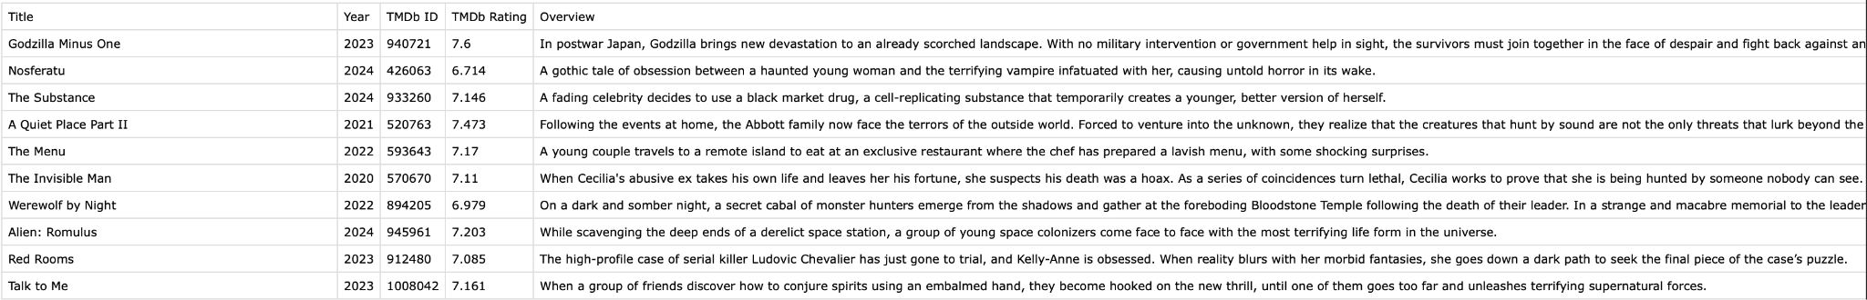
Results

Slide 5
Results
In regards to the questions posed before, the graphs conclude that:
Yes, the quality therefore rating of movies in the horror genre have gone up from the years of 2020 to 2024, with the lowest end being 2020. This was likely due to the ongoing Covid-19 pandemic, which make everything a lot harder to do as no one was going out.
There was a significant increase in horror movie runtime from 2020 to 2024, with the percentage increase being that of ~20%. This percentage became a slight higher in 2022, with a small dip in 2023, then a return to about the same percentage a year later.
Drama, Thriller, and Mystery are the top 3 subgenres when it comes to horror films.
The ten highest ranking films for 2020-2024 are Godzilla: Minus One, The Substance, Nosferatu, A Quiet Place Part 2, The Menu, The Invisible Man, Werewolf by Night, Alien: Romulus, Red Rooms, and Talk to Me. About seven of these ten films have a runtime that exceeds 100 minutes, with The Substance in particular being over 2 hours long. This points directly back to the second question, which highlighted the trend in horror films becoming mucg longer.

Slide 6
Future Work + Questions
While this set up what I wished to accomplish, I would like to implement something such as box office data, alongside an external review website such as Rotten Tomatoes. The two of these resources could really add more onto the aspect of this data being very useful to directors/other creative minds in the industry. Box office numbers and more reviews from other sites such as the aforementioned or even Letterboxd could really help provide insight as to what the current audience really wants out of their horror films. Do they want more Horror Dramas, Horror Thrillers? Do they want longer, more drawn out plots, or something simple and on the short end?
All of these and many more can be added onto this scraper, or even other ones like it.

